Slide 1
Where can it take me?
A set of careers display materials linking school subjects to careers using examples of successful Polish people and people of Polish heritage in Britain.
Notes:
These slides can be printed off for display on A3 or A4 paper.

Slide 2
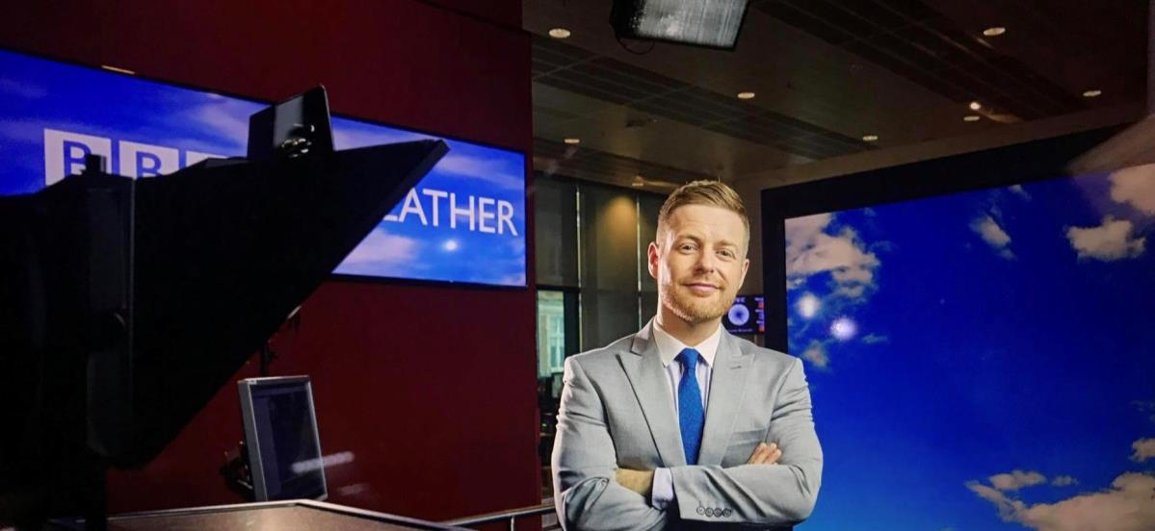
Where can physics and maths take me?
You could forecast the weather on TV!
Tomasz Schafernaker became the youngest man to present the weather on the BBC in 2000. He did A levels in physics and maths after moving to the UK as a child. He was born in Gdańsk in Poland and went to school there too. He did a BSc (Hons) in meteorology at university and then trained as a meteorologist with the UK Met Office.
Notes:
Permission granted to use the image from Tim Reed Management on 1/12/20

Slide 3
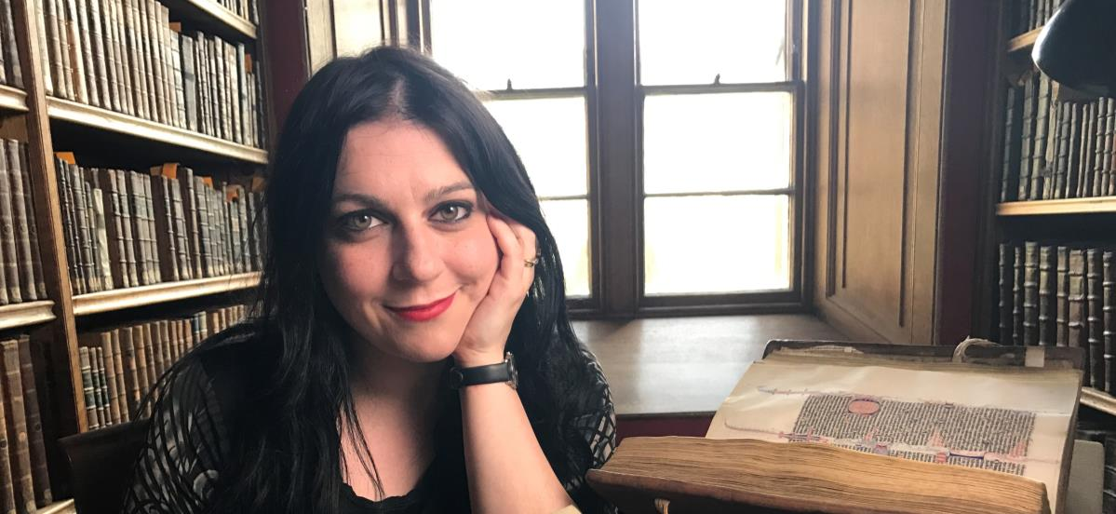
Where can English and history take me?
You could become a TV historian!
Dr Janina Ramirez is a public historian. She teaches, talks and writes about history, English literature and art. After studying English literature at university she went on to do a PhD on Anglo-Saxon birds. She is such a passionate communicator, you will often find her on TV talking about subjects she loves. Her Polish granddad settled in Llandovery in Wales.
Notes:
Image by permission of Dr Janina Ramirez

Slide 4
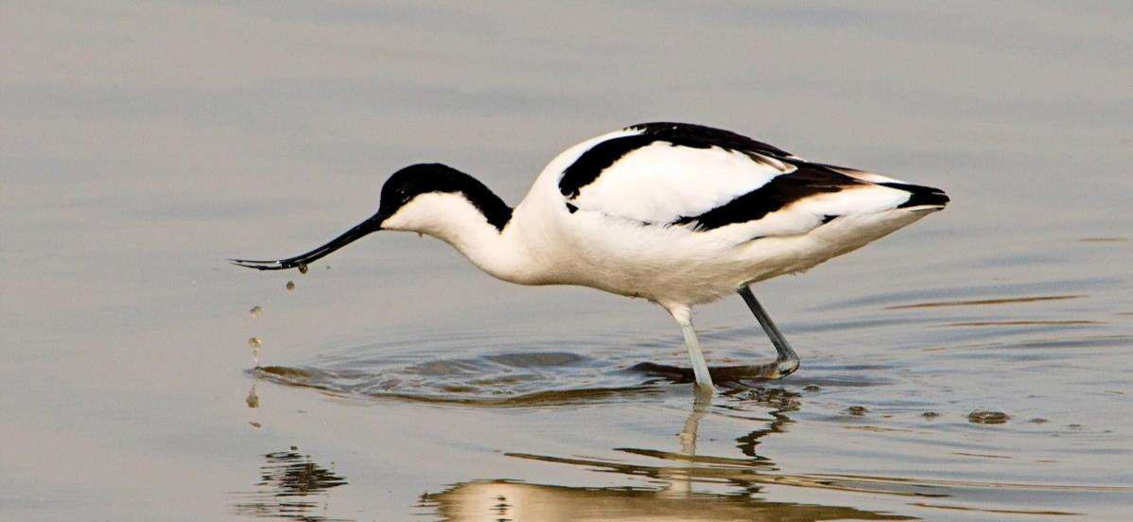
Where can biology and geography take me?
You could work to save birdlife!
Dr Zbig Kapowicz works for the Royal Society for the Protection of Birds (RSPB). His work is about protecting habitats for birds in Europe. His work is based in Cambridge and he travels across the continent working to preserve the environment. He has meetings, he trains people in conservation and he works to persuade people to preserve nature.
Notes:
Creative Commons image

Slide 5
Where can art, design and technology take me?
You could run a fashion business!
Basia Zarzycka has her own shop in Sloane Square, London. She designs, produces and sells clothing and accessories. Her shop is like a magical museum, with every item carefully placed. She started with a stall in Birmingham’s Bull Ring market and her work is inspired by the fairy tales that she read as a small girl, flowers of all kinds and Polish folk history.
Notes:
Image in public domain

Slide 6
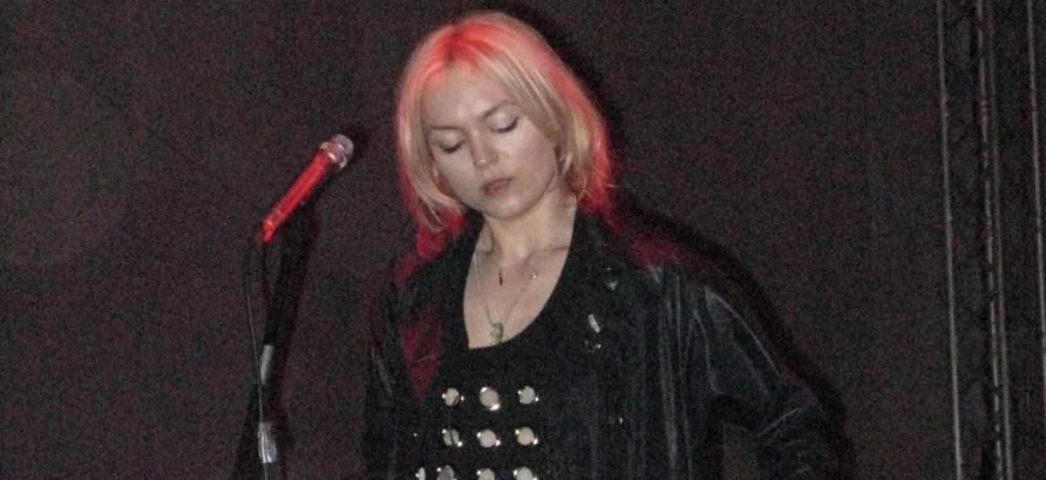
Where can music take me?
You could be an alternative pop artist!
Pati Yang (Patrycja Hilton) is a Polish singer-songwriter who lives in London. She creates music that’s a blend of trip hop, electronica, post-punk and alternative pop. She performs and records and is also a yoga instructor.
Notes:
Image Creative Commons

Slide 7
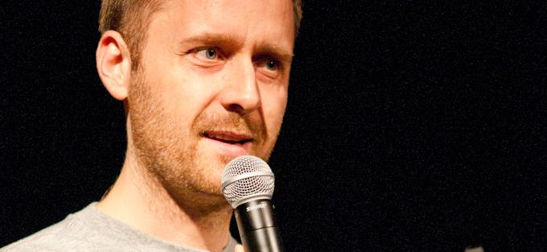
Where can art, coding, design and technology take me?
You could own a video game studio!
CD Projekt Red employs over 800 game-makers from all over the world at its three bases in Poland. They are famous for The Witcher game series and Cyberpunk 2077. It was started by two school friends. By May 2020 the company was valued at US$8.1 billion and was the largest video game industry company in Europe.
Notes:
Creative Commons images

Slide 8
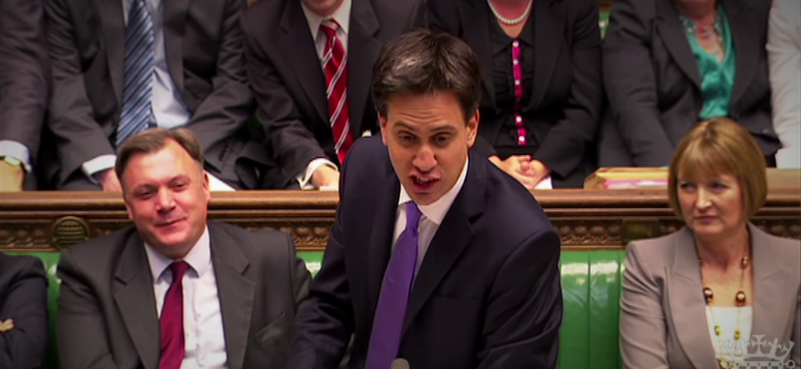
Where can maths, physics and English take me?
You could become an MP!
Ed Miliband is a British Labour Party MP. He was first elected to represent Doncaster North in the UK Parliament in 2005. At university he studied politics and economics, having done A levels in maths, English and physics. His parents both survived the Holocaust and were migrants to Britain. His mother was Polish born.

Slide 9
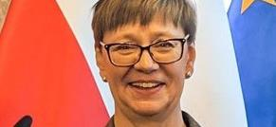
Where does choice of subject not matter so much?
You could work in retail banking!
Małgorzata Horydowiec has built her career working in roles in consumer business and banking. Companies look for people who can prove they:
Are team-players with leadership potential.
Are capable of innovation, adaptation and negotiation.
Have strong communication and problem solving skills.
Ideally have language skills and are willing to live anywhere in the world.
Notes:
Author’s own

Slide 10
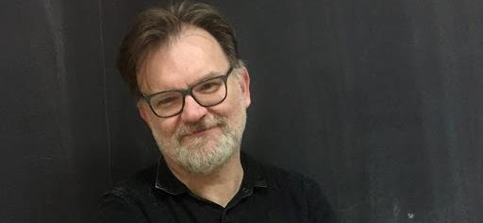
Where can history take me?
You could lead a school!
Jacek Staniszewski set up and leads a free school in Warsaw. He studied history at university and became a teacher. He has worked in museums and an institute for history and citizenship. He also works on history education projects across Europe.
Notes:
Author’s own

Slide 11
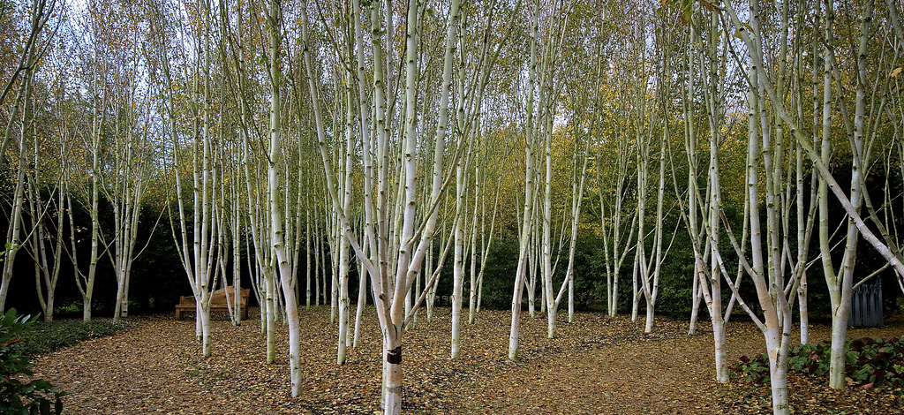
Where can music take me?
You could become a composer!
Roxanna Panufnik is a classical music composer. Her father was also a conductor and composer. He moved to the UK from Poland in 1954. Rosanna studied at the Royal Academy of Music on London. She writes for choirs and orchestras and has written an opera called ‘Silver Birch’.
Notes:
CC image

Slide 12
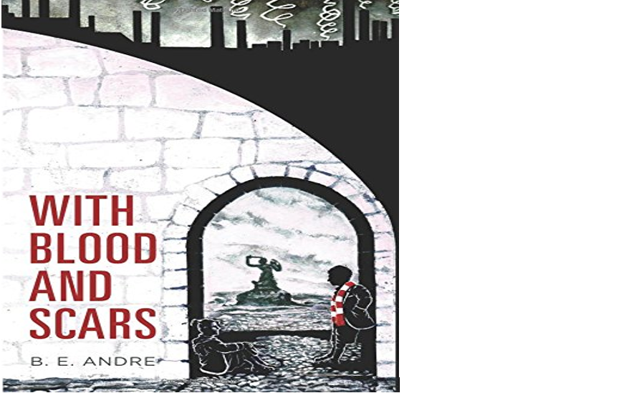
Where can languages take me?
You could write novels!
B.E. Andre’s parents were Polish refugees in England after World War Two. She studied French, German and Swedish at university. Later she did a master’s degree in Critical and Creative Writing. After working as a journalist she turned to writing more fiction and is now a published novelist. Her first novel was called “With Blood and Scars”.
Notes:
CC image

Slide 13
Where can studying French and politics take me?
You could become a journalist!
Kasia Madera is a BBC news journalist and TV presenter. She was born in London to Polish parents. She studied French and politics at university, then trained as a broadcast journalist.
Notes:
Creative Commons image

Slide 14
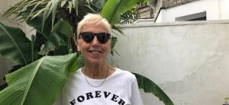
Where can loving writing take me?
To being a writer!
Maria Jastrzębska makes her living writing. She is a poet, an editor, a translator and a playwright. She writes for feminist journals. She was born in Warsaw and moved to the UK with her family when she was a young girl.
Notes:
Thanks to author’s blog.

Slide 15
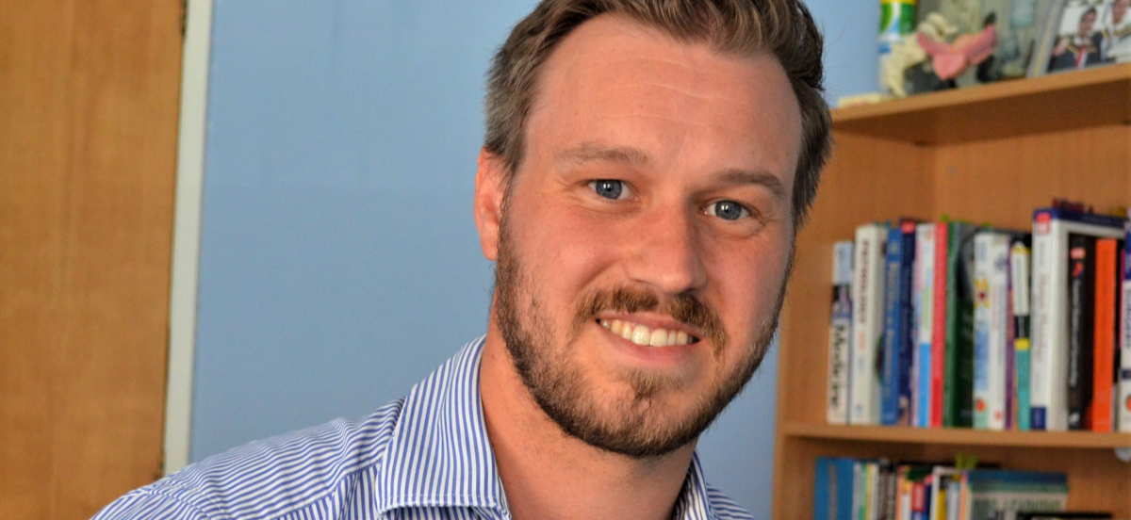
Where can sciences take me?
You could become a GP!
Joe Klakus was born in Hull. His mother was a nurse and his father a doctor. His father was born in a refugee camp in the UK when his grandparents could not return to Poland in 1945. His grandfather was a Polish war hero and his grandmother an army nurse. Joe did science A levels and studied medicine at university.
Notes:
Permission of Joe.

Slide 16
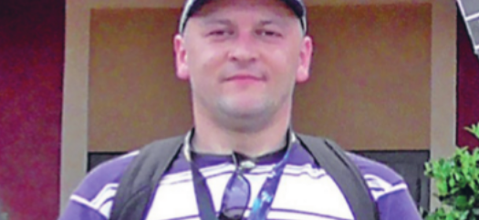
Where can enjoying caring take me?
You could be a care assistant!
Jacek Wandzel was born in Żywiec. When he came to the UK he got work in social care. He helps vulnerable people with their personal needs. He loves helping people to be as independent as they can be.
Notes:
Photo from PolesinUK

Slide 17
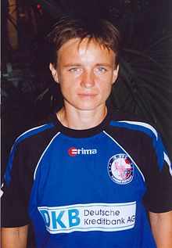
Where can being good at sport take me?
You could be a professional sportsperson!
Maria Makowska achieved over 100 caps for the Polish national team. Mateusz Klich is a Polish professional footballer who currently plays midfield for Leeds United. Anna Rogowska is a world champion pole-vaulter and Justyna Kowalczyk is an Olympic medal-winning cross-country skier. What is your sport?
Notes:
https://en.wikipedia.org/wiki/Mateusz_Klich#/media/File:Mateusz-klich.jpg

Slide 18
Where can being good with words and evidence take me?
You could become a lawyer!
Anna Matelska trained as a lawyer in Poland and the UK. She has set up her own law firm to help Polish people living in Poland and the UK. As an independent solicitor, she represents clients at all stages of the legal process.
Notes:
Creative commons.

