Slide 1
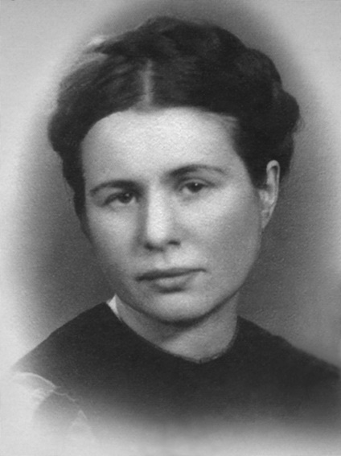
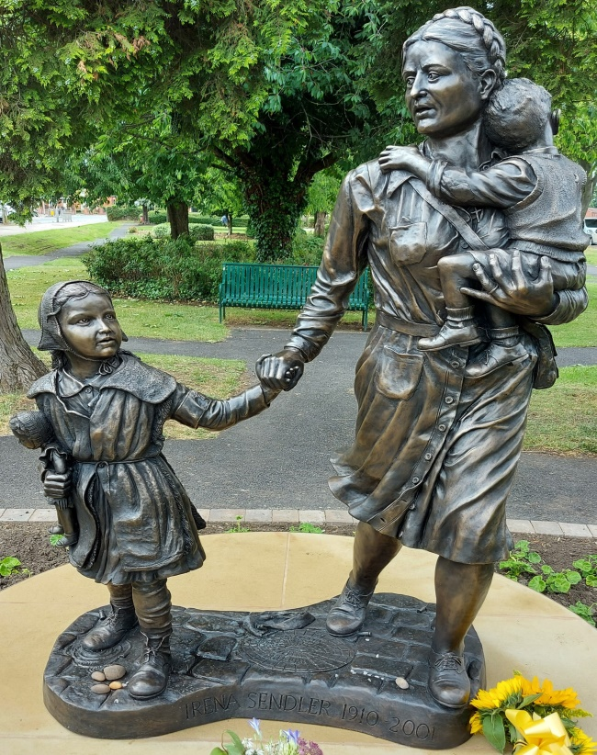
IRENA SENDLER FILM
You are going to watch a short film about a Polish woman called Irena Sendler and the statue of her that stands in Newark on Trent.
Make notes as you watch the film. You can pause the film if you need to.
The link to the film is here:
https://youtu.be/dq0LMlVAFYQ
The introduction
Who was Irena Sendler? ______________________________________________________________
What did she do? ________________________________________________________________
________________________________________________________________________________________________________________________________
Irena is described as an example of empathy, responsibility and solidarity with people in need. Look up these words in a dictionary if you do not know what they mean.
The interview with Andrew Lilley, the sculptor of the Irena Sendler statue
Why did Andrew Lilley choose to create a statue of Irena Sendler? __________________
________________________________________________________________________________________________________________________________________________________________________________________________
Why does he think Irena’s story as an important example for school students? _________
________________________________________________________________________________________________________________________________________________________________________________________________
How challenging was it to create a statue of Irena? ____________________________
________________________________________________________________________________________________________________________________
Over to you!
To find about more about Irena Sendler, ask your teacher, or do an internet search.
Then, reflect on her story.
How is Irena an example of empathy, responsibility and solidarity?
How does she inspire you?

Slide 2
Teacher crib notes for IRENA SENDLER FILM
Student task and film link:
You are going to watch a short film about a Polish woman called Irena Sendler and the statue of her that stands in Newark on Trent.
Make notes as you watch the film. You can pause the film if you need to.
The link to the film is here: https://www.youtube.com/watch?v=6l4PXbWRBqk
The introduction
Who was Irena Sendler? A Polish social worker during World War Two.
What did she do? Saved more than 2000 Jewish children by hiding them from the Nazi German military, and then smuggling them, one by one, out of the Warsaw ghetto.
She risked her life to do that. She placed the children in families with fake identities so that they would be safe until the end of the war.
Irena is described as an example of empathy, responsibility and solidarity with people in need. Look up these words in a dictionary if you do not know what they mean.
The interview with Andrew Lilley, the sculptor of the Irena Sendler statue
Why did Andrew Lilley choose to create a statue of Irena Sendler? His main reason was that Irena crossed cultural, religious boundaries to risk her life for others. She is the best example of the best human qualities that he has ever come across. She is extremely inspiring.
Why does he think Irena’s story as an important example for school students? Because it is a story of risking her life to save children and their identities and to provide them with a future, regardless of who they were and where they came from. Her love and care for children is inspiring.
How challenging was it to create a statue of Irena? There are not many pictures of her, so it was challenging to create a statue of her in her early 30s and to capture the fear she must have felt, and the immense spirit that she had.
Over to you!
To find about more about Irena Sendler, ask your teacher or do an internet search.
Then reflect on her story.
How is Irena an example of empathy, responsibility and solidarity?
How does she inspire you?
Irena Sendler is recognised by Yad Vashem as one of the Righteous Among the Nations and you can find out more about her here: https://www.yadvashem.org/yv/en/exhibitions/righteous-women/sendler.asp
For more teaching resources about Irena Sendler, Poland and Polish life follow this link: https://instytutpolski.pl/london/education/

